Slide 1
Fauna Find Project
</
} /> [
/>
Using YOLO Model for Animal Detection

Slide 2
01
Project Overview
</>
} /> [

Slide 3
</ Project Overview
Objective | To detect animals in images using a pre-trained YOLO model.
Tools used | Python, Tkinter, PIL, YOLOv5

Slide 4
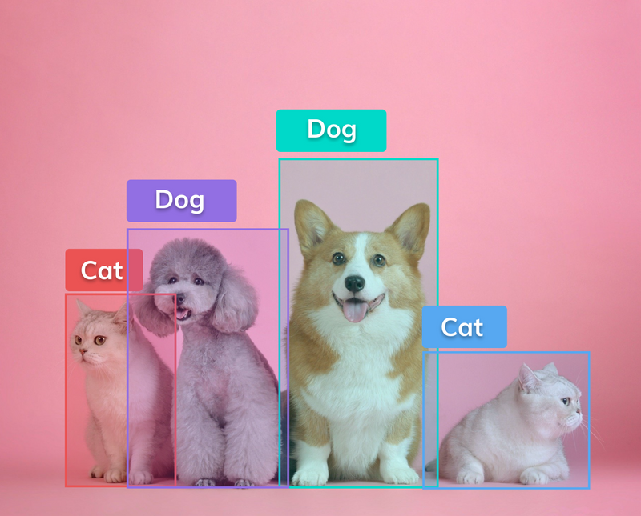
</ Aim
Develop a robust application to detect and identify various animals in images by fine-tuning a pre-trained YOLO model using a custom dataset.
YOLO>

Slide 5
</ Objectives
Model Training:
Fine-tune a pre-trained YOLO model using a custom dataset of various animals.
Optimize the model for high accuracy and performance.
YOLO>

Slide 6
</ Objectives
Evaluation:
Evaluate the model's performance using metrics like the confusion matrix to ensure accuracy and identify areas for improvement.
YOLO>

Slide 7
</ Objectives
Application Development:
Integrate the fine-tuned YOLO model into a Python application.
Use Tkinter to create a graphical user interface for easy image loading and processing.
YOLO>

Slide 8

</ What is YOLO?
YOLO (You Only Look Once) is a state-of-the-art, real-time object detection system. It stands out from other object detection algorithms due to its unique approach and efficiency.
Purpose: Object detection system that predicts bounding boxes and class probabilities directly from full images in one evaluation.
YOLO>

Slide 9
</ What is YOLO?
How it works
Single Neural Network: YOLO uses a single convolutional neural network (CNN) to predict multiple bounding boxes and class probabilities for those boxes.
Unified Detection: It treats object detection as a single regression problem, straight from image pixels to bounding box coordinates and class probabilities.
YOLO>

Slide 10
</ Project Overview
DataSet | Drive
Training Process | Collab
Results | Here

Slide 11
02
Model Evaluation
</>
} /> [

Slide 12
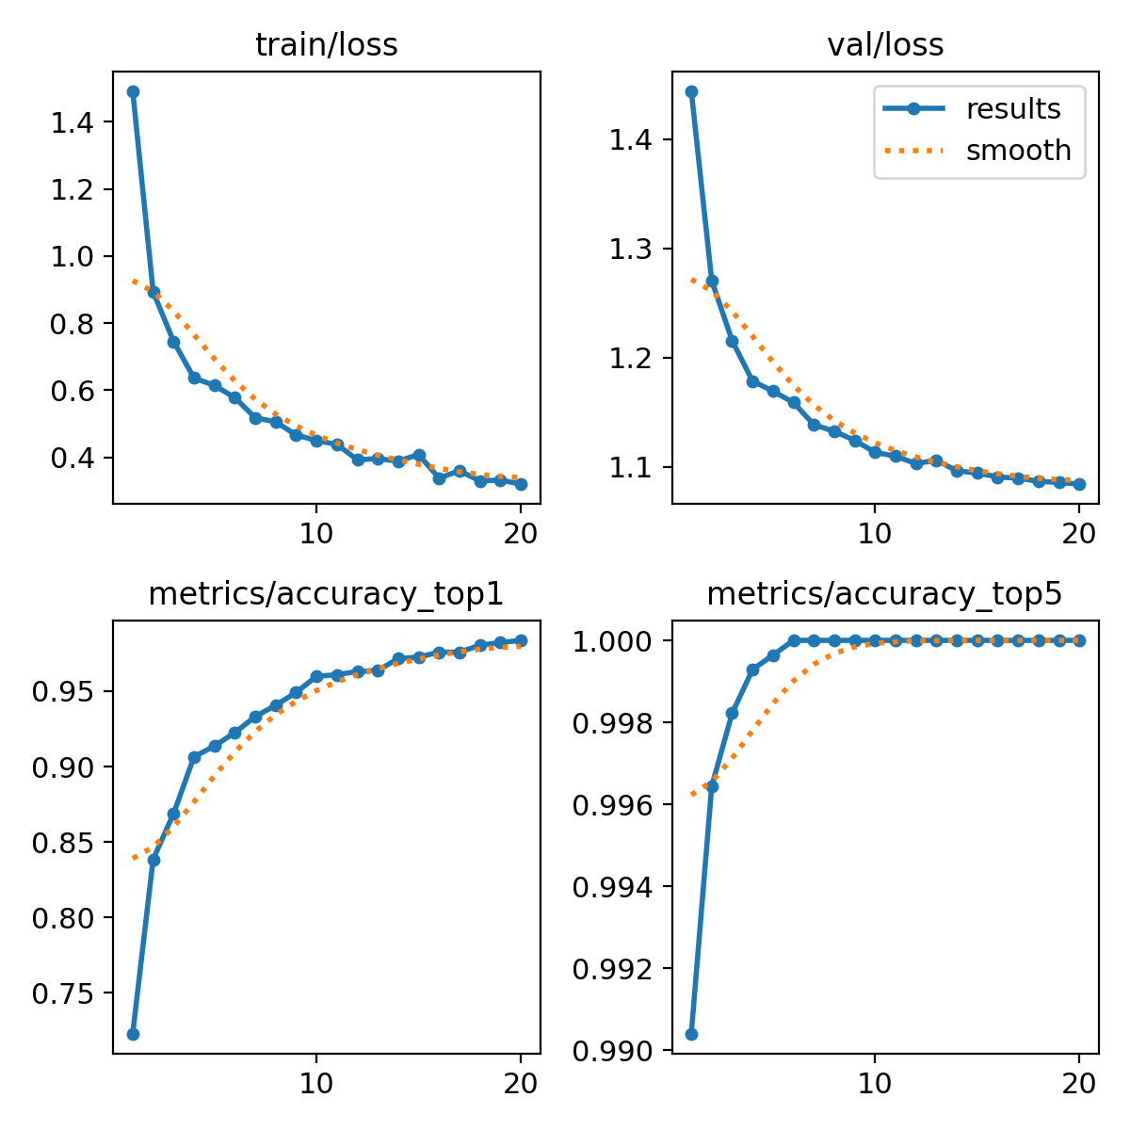
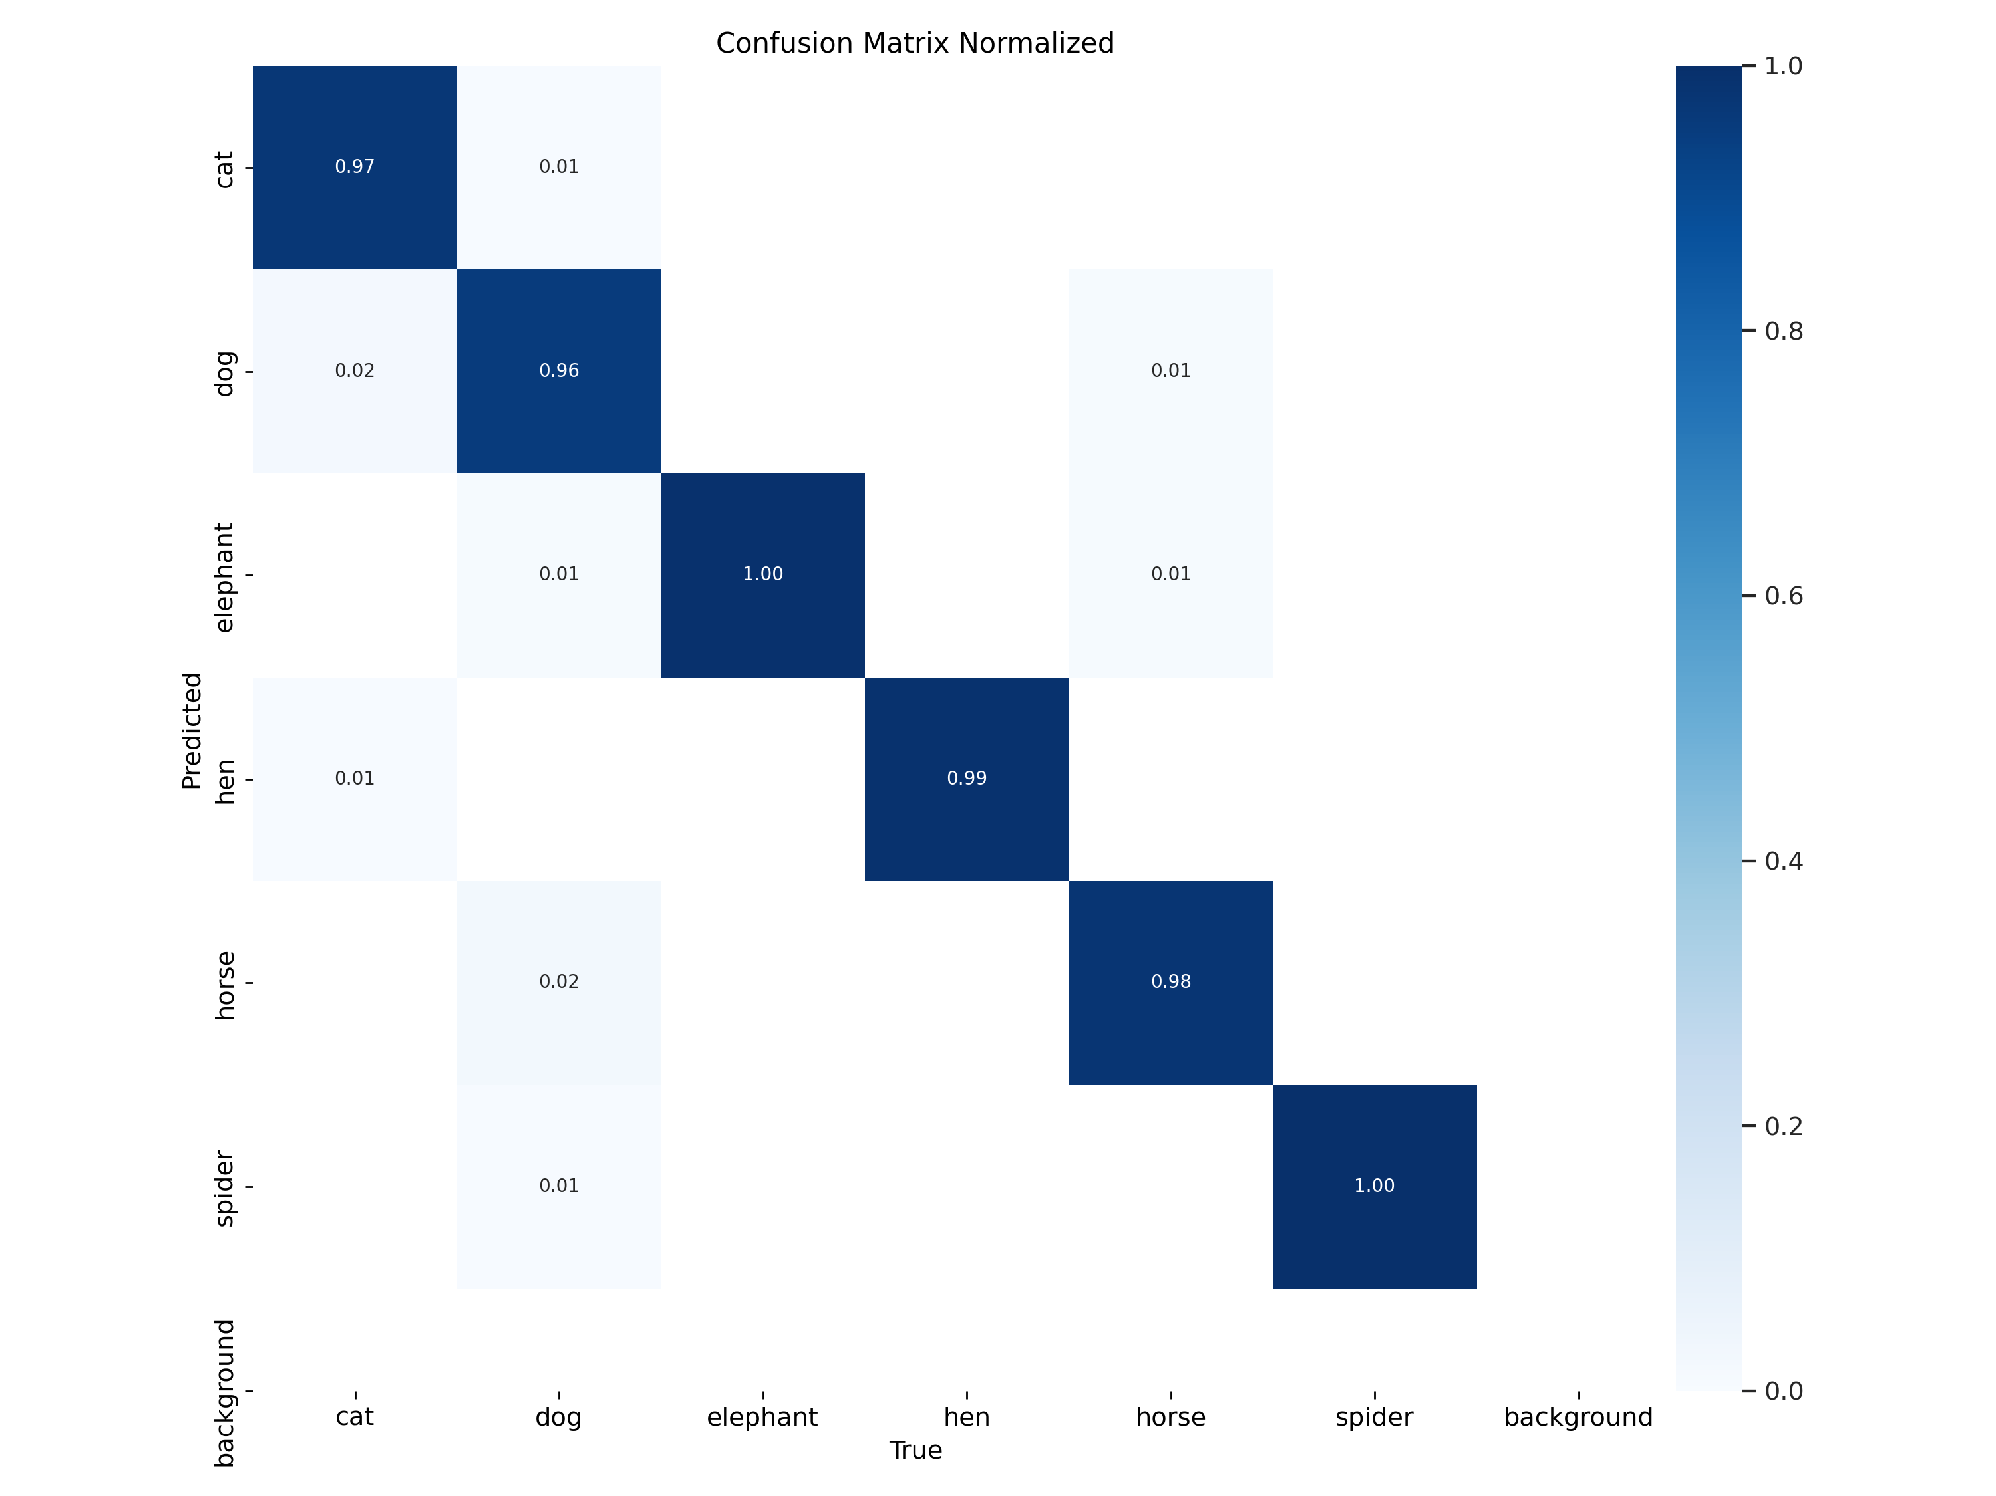
</ Training Results/Evaluation

Slide 13

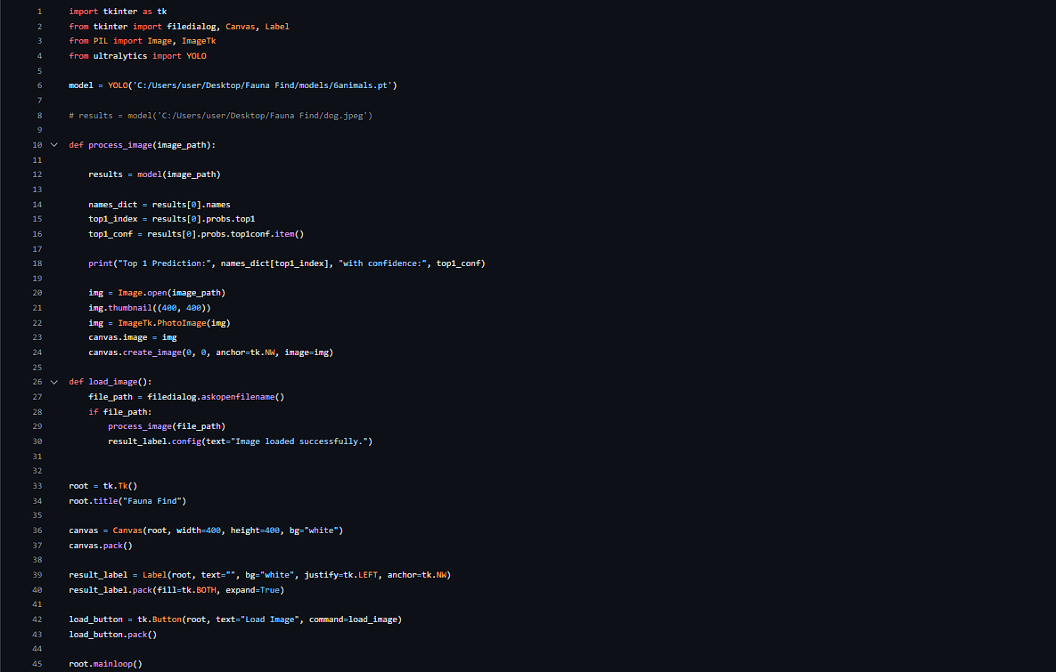
</ Training Results/Evaluation

Slide 14
</ Project Demo

Slide 15
0.0
Credits
</
Dataset
ultralytics
} /> [

Slide 16

0.0
Thanks!
</
Do you have any questions?
Project Repository:
} /> [

